Slide 1
Should we say no to GMOs?
Metabolic Disease
Case Study 1

Slide 2
Learning Objectives
At the end of today’s lesson you will be able to:
Describe the basic process used to create a GMO.
List reasons people are opposed to, or in support of GMO crops.
Identify bias in resources.
Evaluate a resource using the CRAAP test.

Slide 3
Do Now
What does “GMO” stand for?
GMO stands for Genetically Modified Organism
This means the genetic sequence of the organism has been altered

Slide 4
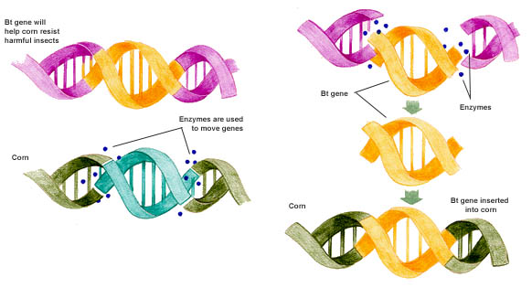
Do Now
How are GMOs created?
Bacterial DNA
Bt gene
Enzymes
Enzymes
Corn DNA

Slide 5
What side are you on?video
Notes:
Video length: 3:19

Slide 6
Fact or Opinion?
Most corn and soy in the US are genetically modified
Source: USDA
Most of the general public is NOT okay with GMOs, while most scientists are okay with GMOs
Source: Pew Research Center
GMOs are necessary to feed the world’s growing population
Source: None
FACT
FACT
OPINION

Slide 7
Fact or Opinion?
Most studies have found that GMOs present no harm to human health
Source: Dr. Pamela Ronald; University of California Davis
GMOs impact the environment by contributing to climate change
Source: Center for Food Safety
Corporations are about making money, not sustainability or health
Source: none
FACT
OPINION
OPINION

Slide 8
Fact or Opinion?
Farmers must purchase GM seeds from the manufacturers, instead of saving them from their own crops each year.
Source: None
Glyphosate (the key ingredient in the pesticide RoundUp) is linked to Parkinson’s disease, cancer, food allergies, obesity, infertility and autism
Source: Entropy, 2013
FACT
Unconfirmed

Slide 9
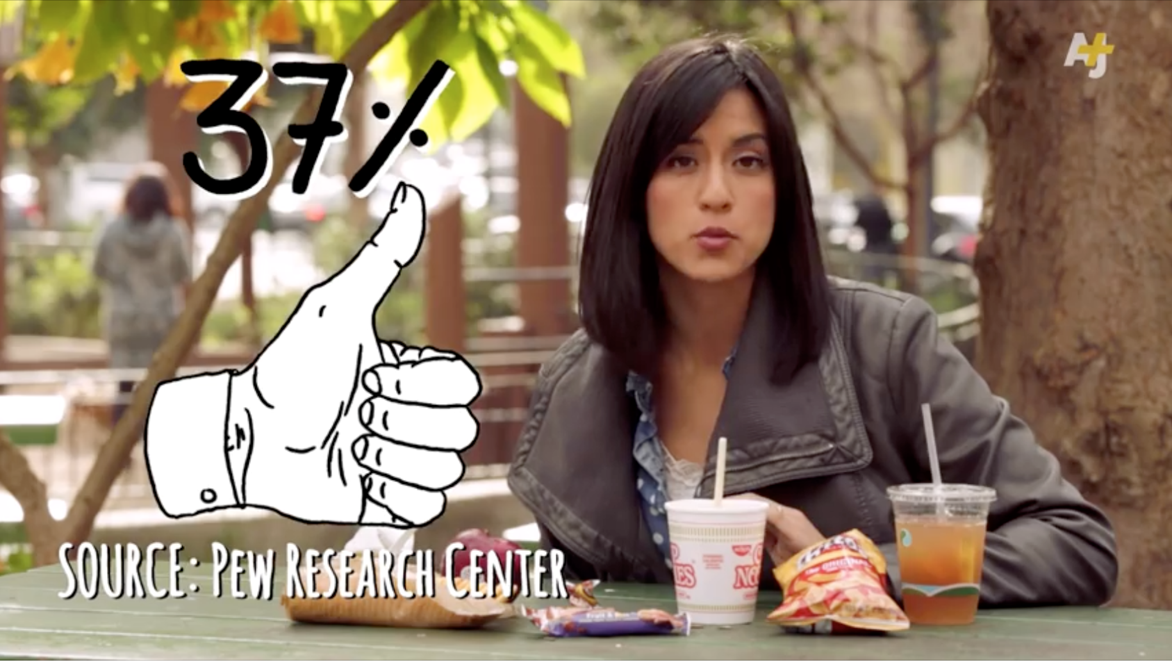
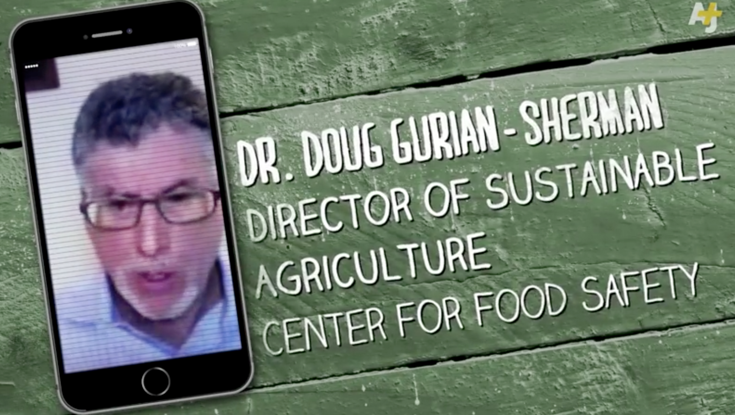
How do you know what and who to trust?

Slide 10
Evaluating a Source
Let’s dig deeper into the scientific article published in Entropy

Slide 11
Reading a scientific research article is HARD! Before you read an article decide if it’s worth your time by asking…
Is it CRAAP?

Slide 12
Check your sources: the CRAAP test
✓
Currency
✓
Relevance
✓
Authority
✓
Accuracy
✓
Purpose
Is the information out of date?
When was it published?
How is this information relevant to your topic (in this case, GMOs)? Is this a review of other scientists work, or did the authors do their own studies?
Who wrote this and what are their qualifications? Is there any bias? Is the author well-known and well regarded?
Is this a reliable source? Are there citations to other reliable sources? Does the information make sense, scientifically?
What is the purpose of the website? Is it meant to inform, teach, or persuade? Can you find bias, or emotional language?
Notes:
Use the CRAAP test before reading an article, it will save you from wasting time on an unreliable source!
Hand out the first page of the Entropy article to students so they have the title and abstract.

Slide 13
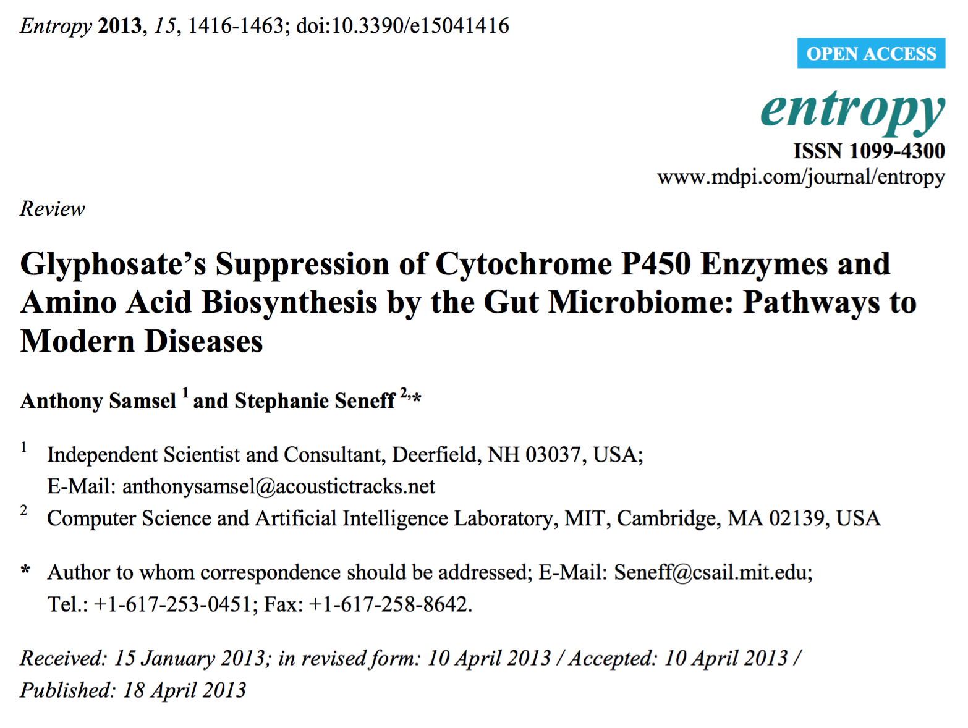
✓
Currency
Is the information out of date?
When was it published?

Slide 14
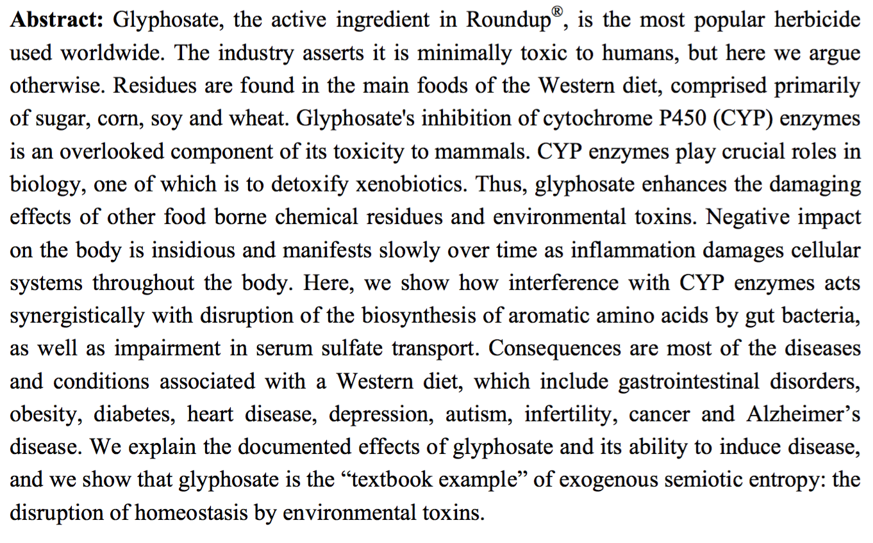
How is this information relevant to your topic (in this case, GMOs)? Is this a review of other scientists work, or did the authors do their own studies?
✓
Relevance

Slide 15
✓
Authority
Who wrote this and what are their qualifications? Is there any bias? Is the author well-known and well regarded?
Notes:
Ask the students who wrote this article, and what are their qualifications (i.e. where do they work)? Do they work for non-biased organizations? Well-known universities?
Every published scientific article will give the authors’ names and their affiliations, as well as any conflicts of interest the authors declare. One author in this article identifies as an “independent scientist”, which should raise alarm. An independent scientist, without ties to a research institute, company or university is unlikely to have funds and resources to conduct research. (Note that even though this is a review article, it is important for the authors to have experience doing research in the field first-hand so they have a deep understanding of the field.) The other author is listed as being in the field of computer science and artificial intelligence at MIT. This is suspicious, as it is odd that a computer scientist is also a specialist in the gut microbiome and pathways to modern disease, both complicated biological topics.
If students have access to the internet they can search for the authors’ names to see other research the authors have conducted. More credible authors will have several articles published in the field.
Ask the students if they see anything concerning about the authors and their affiliations (red flag)

Slide 16
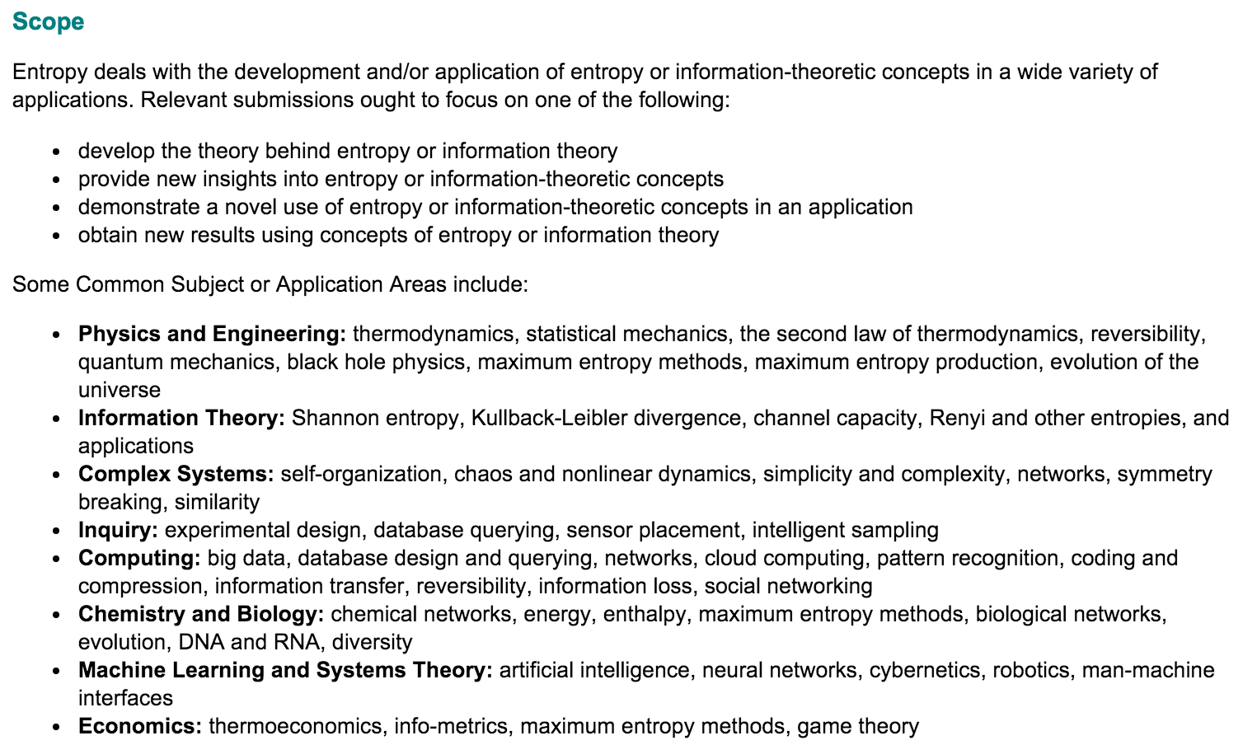
✓
Accuracy
Is this a reliable source? Are there citations to other reliable sources? Does the information make sense, scientifically?
From the Entropy website:
Notes:
Ask students whether the journal Entropy is a reliable source of information for the field of GMOs.
Ask whether there are parts of the abstract that raise concern.

Slide 17
✓
Accuracy
Is this a reliable source? Are there citations to other reliable sources? Does the information make sense, scientifically?
Notes:
Ask whether there are parts of the abstract that raise concern.

Slide 18
✓
Purpose
What is the purpose of the website? Is it meant to inform, teach, or persuade? Can you find bias, or emotional language?
What is the purpose the journal Entropy?
What is the purpose of the article published in Entropy?
Notes:
Ask students what the purpose of the journal Entropy is, and what the purpose of the article is.

Slide 19
Is the article in Entropy a reliable source?

Slide 20
Wrap Up: Is this video biased?

